Slide 2
Speak to your Game
Conversational AI in games
Notes:
Welcome everybody to this presentation about using Conversational AI in games

Slide 3
Zee Nastalski Innovation Specialist zee.nastalski@newcastle.edu.au
Notes:
My name is Zee Nastalski, I came from University of Newcastle where I work as an Innovation Specialist which in my case means I am a software engineer.

Slide 4
Goal: AI Chatbot in 30 minutes with Unity
Notes:
So our ambitious goal for today is to learn AI chatbot technology… in 30 minutes … with Unity.
In fact, what you will see here goes beyond unity. All of the concepts apply to chatbots for web which You probably have encountered somewhere.
The chatbots tend to show up in many places and act as virtual assistants or customer support agents. (Jess from Jetstar).
They live in your phones of course. We are not able to have meaningful conversation with them but they are capable of making notes or appointments for us. They can also order some pizza us.

Slide 5
Why?
Because We Can!
Useful in VR and AR
it’s a good fun
Notes:
Why would we want to use the chatbot technology in games
Because we finally can
Making an app or a game that can listen to human voice, “understand” it and have enough content in it to give some useful responses was a difficult task.
In recent years technologies required to make this task possible finally converged:
- Cloud computing: all of the tools for making the chatbots are cloud based and there are some good reasons for it I’ll talk about later
- Machine Learning – the algorithms have been around for a while now but they are getting better all the time
- Machine Learning on GPU – gives required horsepower to scale the cognitive API services to masses
- Deployment of 4G networks – we can steam voice over 4G so it can be recognized in the cloud and results returned near-real time.
On the other hand:
- VR – keyboards are not practical in VR, hands are used for bows and arrows
- mobile AR – we want users to hold their iPads pro in both hands
These are early days of conversational AI but there are some good use cases for it.
Also, the tools for creating conversational AI technology are easy to use

Slide 6


Slide 7
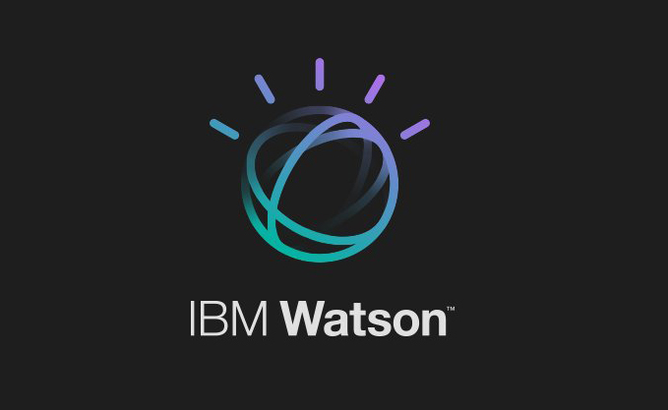
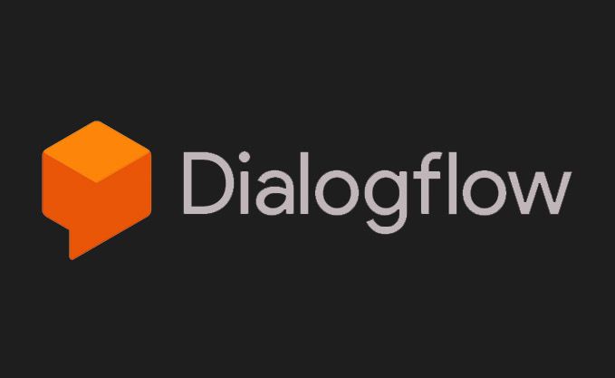

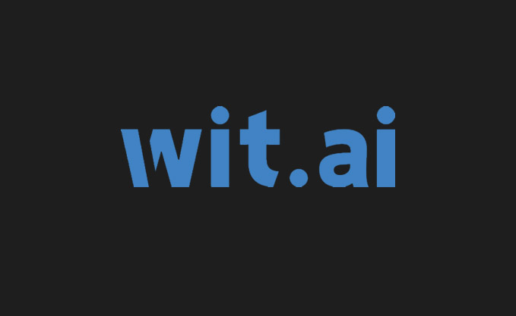

Tools:
Notes:
Talk about what is owned by who
- IBM Watson
- Dialogflow (Google)
- Microsoft Cognitive
- Wit.AI
- Amazon
These are the big players only. Some of them are free and some of them tend to give the API response faster than others. All of them give a set of APIs that can be used for chatbots and other AI things as well.
For our demo today I chose IBM Watson mostly because it has
- most complete, mature unity SDK - out of beta as of September this year.
- open source.
- It is well documented and
- works asynchronously
It is not free but you can get 30 day trial without giving credit card details. After that, they give you free API call limits and they charge you only if you exceed these limits.
If you want to use it for a production title make sure you understand the biz side of things.

Slide 8
Full C# open source
Asynchronous
All platforms except WebGL
Offers more than conversational AI
Not Free
Notes:
Talk about what is owned by who
- IBM Watson
- Dialogflow (Google)
- Microsoft Cognitive
- Wit.AI
- Amazon
These are the big players only. Some of them are free and some of them tend to give the API response faster than others. All of them give a set of APIs that can be used for chatbots and other AI things as well.
For our demo today I chose IBM Watson mostly because it has
- most complete, mature unity SDK - out of beta as of September this year.
- open source.
- It is well documented and
- works asynchronously
It is not free but you can get 30 day trial without giving credit card details. After that, they give you free API call limits and they charge you only if you exceed these limits.
If you want to use it for a production title make sure you understand the biz side of things.

Slide 9
Problems to Solve:
Natural Language
“Understanding”
Speech To Text
Text To Speech
Intent
Classification
Entity
Extraction
Notes:
Ok, so what problems do these tools solve for us.
Let’s go left to right:
Speech-to-text
- streaming API
- context aware pre-trained ML model to aid speech recognition with probability of certain word in the context of the sentence (I want to eat a Hamburg)
- Ability to train on custom model (maybe you are making game about eating cities in Germany).
Text-to-speech
- This is fairly intuitive. Only thing to say is that the quality got really good in recent years.
- You may not even need it.
So now, what is this mysterious and exciting natural language understanding.
- It can be understood very broadly but the
- current generation of chatbot tools break it down into two simple problems

Slide 10
Intents:
#greetings
Hi, My name is Zee
Hello Computer Good Morning How do you do
G’day
#goodbyes
Bye!
See you later thanks, goodbye. Have a nice day
So long
Notes:
Abstraction about user’s intention and is defined by number of examples of how this intention may be expressed.
The power of this service is that it is able to classify sentences it was not trained on.
It classifies a sentence as the intent and as programmers we don’t have to worry how exactly this intent was expressed by the user.

Slide 11
Entities:
Fire the missile!
Shoot them down with a rocket
Intent: #fire Entities:
@weapon:projectile
Notes:
Entities are things in sentence that we want to extract. Often they are subject of some action we want to do.
In this example we have entity type appliance and the value is lights
In the code we don’t have to worry which synonym of lights the user used. The system works this out for us and we only have to deal with entity type.

Slide 12


Speech
to text
AUDIO
TEXT
speech
user
text
conversation
speech
text
SPEECH
text to speech
Notes:
Entities are things in sentence that we want to extract. Often they are subject of some action we want to do.
In this example we have entity type appliance and the value is lights
In the code we don’t have to worry which synonym of lights the user used. The system works this out for us and we only have to deal with entity type.

Slide 13
Some Considerations:
Make it respond fast
Tell users what they can talk about
Train a lot, also after going live
Train Speech To Text with your custom model
Use Push-To-Talk
Have a backup

Slide 14
Thank you!
Resources: https://github.com/ZeeNastalski/unity-watson-chat

